Slide 1
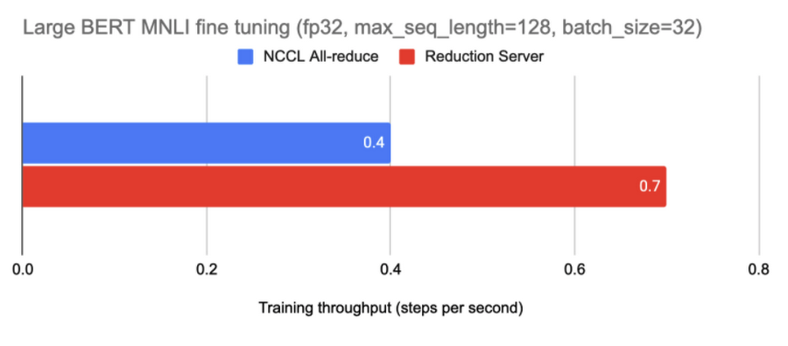

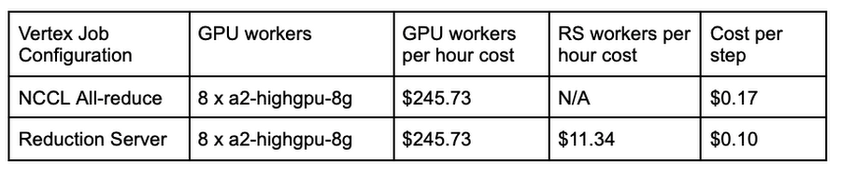
Vertex AI Training
Reduction Server
Optimize distributed GPU training for synchronous data parallel algorithms
Training time is a key bottleneck
The exponential growth of datasets and model sizes has caused training time to become one of the key bottlenecks in the development and deployment of ML systems.
Distributed training at scale is difficult
Limited network bandwidth between nodes makes optimizing performance of distributed training inherently difficult, particularly for large cluster configurations.
Reduction Server allows for faster distributed training
A faster GPU all-reduce algorithm developed at Google optimizes bandwidth and latency of multi-node distributed training on NVIDIA GPUs for synchronous data parallel algos.
Adding 20 reduction server nodes increased the training throughput by 75%.
Framework agnostic
Support mainstream deep learning frameworks including TensorFlow, PyTorch, JAX.
Seamless integration with existing training jobs Zero-touch enablement for your multi-worker GPU training jobs on Vertex AI Training with optimized training bandwidth and latency.
Reduced cost per step by 42% even with additional nodes.

